Slide 1


FACULTY OF APPLIED SCIENCE & TECHNOLOGY
DEPARTMENT OF COMPUTER SCIENCE
GROUP 5
TOPIC:
MOBILE BASED CROP DISEASE DETECTION AND ADVISORY SYSTEM FOR TOMATO AND MAIZE CROPS
PROJECT TEAM (PRESENTERS):
Ntiamoah Prince Agyei (STUBTECH220135) | Adjei Sarfo Joseph (STUBTECH221244)
Abdul Wasiu Abubakr (STUBTECH220035) | Lomotey Nathaniel Julian (STUBTECH220073)
Supervisors: Mr. Buabeng Solomon & Mrs. Awuti Mensah
PROJECT TEAM (PRESENTERS):
Ntiamoah Prince Agyei (STUBTECH220135) | Adjei Sarfo Joseph (STUBTECH221244)
Abdul Wasiu Abubakr (STUBTECH220035) | Lomotey Nathaniel Julian (STUBTECH220073)
Supervisors: Mr. Buabeng Solomon & Mrs. Awuti Mensah
PROJECT TEAM (PRESENTERS):
Ntiamoah Prince Agyei (STUBTECH220135) | Adjei Sarfo Joseph (STUBTECH221244)
Abdul Wasiu Abubakr (STUBTECH220035) | Lomotey Nathaniel Julian (STUBTECH220073)
Supervisors: Mr. Buabeng Solomon & Mrs. Awuti Mensah
PROJECT TEAM (PRESENTERS):
Ntiamoah Prince Agyei (STUBTECH220135) | Adjei Sarfo Joseph (STUBTECH221244)
Abdul Wasiu Abubakr (STUBTECH220035) | Lomotey Nathaniel Julian (STUBTECH220073)
Supervisors: Mr. Buabeng Solomon & Mrs. Awuti Mensah
2025/2026

Slide 2
Problem Study
Economic Importance: Agriculture contributes ~20% of Ghana's GDP and employs over 40% of the rural workforce.
Staple Crop Vulnerability: Tomato and Maize face destructive fungal, bacterial, and viral pathogens, causing 30% to 80% annual harvest losses. (Shrivastava et al., 2023)
Severe Extension Shortage: Developing farming districts average only 1 agricultural extension officer per 1,500+ smallholder farmers. (Danquah et al., 2024)
Diagnostic Misclassification: Visual symptom overlap between blights and leaf spots leads to improper agrochemical application and crop damage. (Okafor & Appiah, 2024)
The Core Need: A low-latency, 100% offline, intelligent mobile diagnostic tool providing instant verified agronomic advice.

Slide 3
Research Gap
Heavy Cloud Model Dependency: Prior CNN architectures (AlexNet, DenseNet-121 >100 MB) rely on cloud servers and GPU clusters, unviable for remote rural farms. (Mohanty et al., 2016; Too et al., 2019)
Spatial Lesion Information Loss: Conventional channel attention (SE-Net) compresses channels via global average pooling, discarding vital spatial lesion cues. (Hu et al., 2018; Misra et al., 2021)
Black-Box AI Trust Barrier: Standard deep networks output raw labels without visual explanations, causing skepticism among cautious farmers and agronomists. (Rahman et al., 2024; Vyas et al., 2023)
Rural Connectivity Constraints: Sub-Saharan rural farming belts face widespread cellular blind-spots, rendering cloud-dependent diagnostic APIs unusable. (Mishra et al., 2024)
Fragmented Actionable Remedies: Existing diagnostic tools identify pathologies without embedding localized, actionable chemical and organic treatment protocols. (Silva & Santos, 2025)

Slide 4
Objectives (General and Specific)
General Objective (Scientific AI Research): Design, train, optimize, and empirically validate an attention-enhanced, INT8-quantized deep learning model with visual Grad-CAM explainability for accurate 14-class Tomato and Maize pathology diagnosis.
General Objective (Mobile Model Integration): Engineer and deploy a cross-platform, 100% offline Flutter mobile application embedding the lightweight on-device inference runtime paired with a local SQLite agronomic treatment database.
Specific Objective 1 (Model Architecture): Train an EfficientNet-B0 backbone fused with a 3-branch Triplet Attention mechanism across 14 Tomato & Maize categories.
Specific Objective 2 (Edge Quantization): Quantize the deep network using INT8 Post-Training Quantization to achieve <10 MB footprint and <100 ms mobile latency.
Specific Objective 3 (Explainability Layer): Embed Grad-CAM visual heatmaps for transparent, verified crop pathology decision-making directly on-device.
Specific Objective 4 (Mobile & SQLite Integration): Build a cross-platform Flutter application with an embedded offline SQLite disease dictionary and treatment protocol repository.
Specific Objective 5 (Field Usability Evaluation): Empirically evaluate real-world usability and farmer acceptance using the System Usability Scale (SUS).

Slide 5
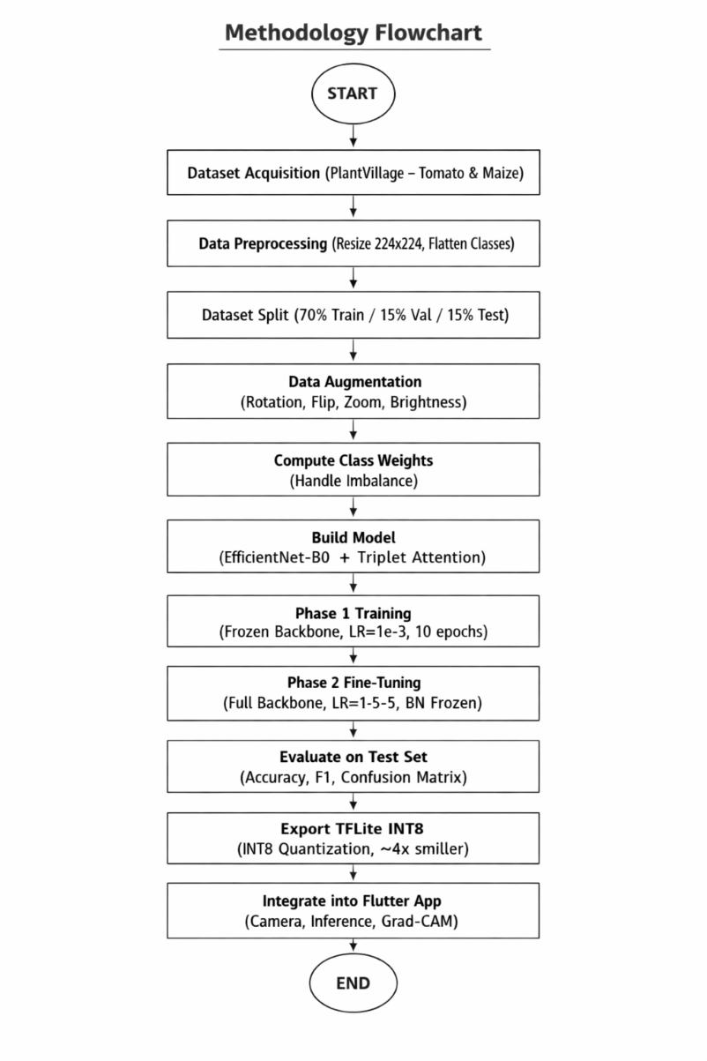
Methodology
Phase 1 (Data Prep & Augmentation): 224x224 RGB normalization, random rotation, zoom, flips, and lighting adjustments.
Phase 2 (Model Architecture): EfficientNet-B0 compound scaling backbone fused with a 3-branch Triplet Attention module.
Phase 3 (Transfer Learning): Two-phase training schedule: feature head extraction (10 epochs) followed by fine-tuning (30 epochs).
Phase 4 (INT8 Edge Quantization): TensorFlow Lite post-training quantization with representative dataset calibration (20.3 MB -> 5.1 MB).
Phase 5 (Mobile App Engineering): Cross-platform Flutter frontend + on-device TFLite interpreter + local SQLite treatment engine (100% offline). (Sarker et al., 2024; Varghese & George, 2025)
Phase 6 (XAI & Field Testing): Grad-CAM visual attention verification + empirical 10-item Likert SUS evaluation on 15 agricultural participants.

Slide 6
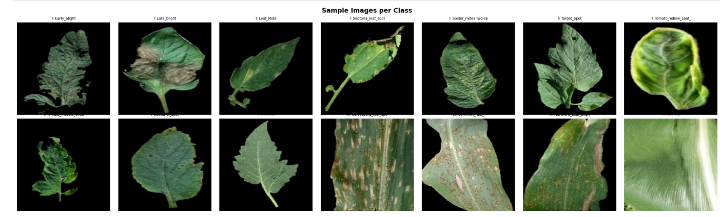
Methodology Flowchart & System Architecture

Slide 7
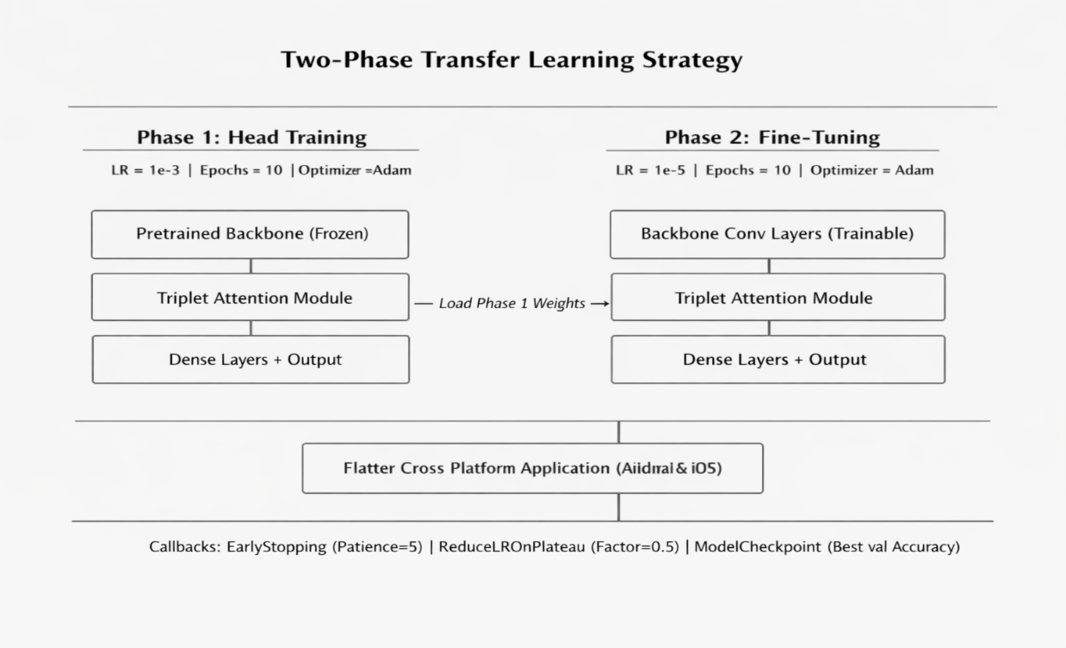
Dataset Preprocessing and Augmentation Pipeline
Augmentation Technique | Parameter Value | Technical & Agronomic Rationale
Random Rotation | ±30° | Simulates varied leaf angles relative to smartphone camera in field conditions.
Width Shift | ±15% | Handles off-centre leaf positioning within the camera viewfinder.
Height Shift | ±15% | Compensates for vertical framing variations during handheld farmer capture.
Shear Angle | ±15% | Simulates perspective distortion caused by oblique camera tilting.
Random Zoom | ±20% | Replicates varying handheld distances from leaf surface to camera lens.
Horizontal Flip | Enabled (50%) | Leaf disease symptom patterns exhibit vertical bilateral symmetry.
Vertical Flip | Enabled (50%) | Accounts for inverted or downward-hanging leaves on crop canopies.
Brightness Range | [0.7 – 1.3] | Simulates variable outdoor solar illumination (direct sunlight to heavy overcast).
Channel Shift | ±25.0 | Models sensor color balance variations across budget smartphone models.
Fill Mode | Reflect | Maintains natural leaf texture continuity at image borders after geometric transforms.

Slide 8
PlantVillage 14-Class Sample Leaf Dataset Grid

Slide 9
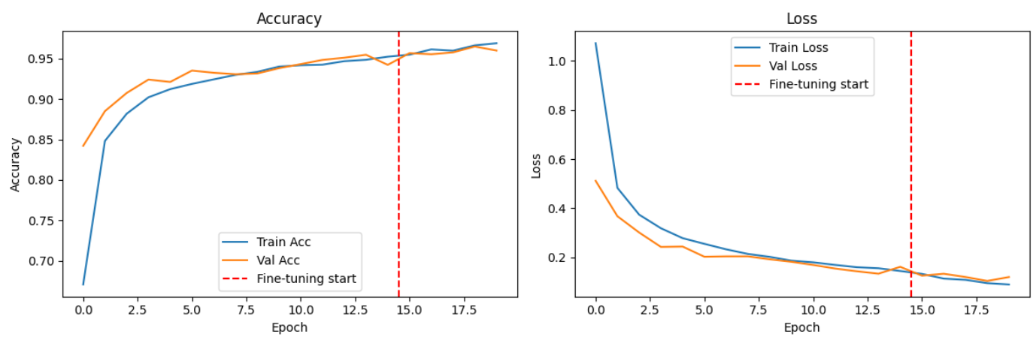
Model Architecture & Triplet Attention
EfficientNet-B0 Backbone: Compound scaling uniformly scales depth (d = alpha^phi), width (w = beta^phi), and resolution (r = gamma^phi) for optimal FLOPs efficiency. (Tan & Le, 2019)
Triplet Attention Module: Constructs cross-dimension tensor interaction without dimensionality reduction across 3 parallel rotation branches: (Misra et al., 2021; Liu & Wang, 2025)
Branch 1 (Channel-Height): Rotates tensor to (H x C x W) to capture spatial height and channel correlations.
Branch 2 (Channel-Width): Rotates tensor to (W x H x C) to capture spatial width and channel correlations.
Branch 3 (Spatial H x W): Applies spatial attention over (C x H x W) via 7x7 spatial convolution.
Advantage over SE-Net & CBAM: Preserves fine-grained spatial lesion boundaries (e.g. Septoria spots, rust pustules) without parameter overhead.

Slide 10
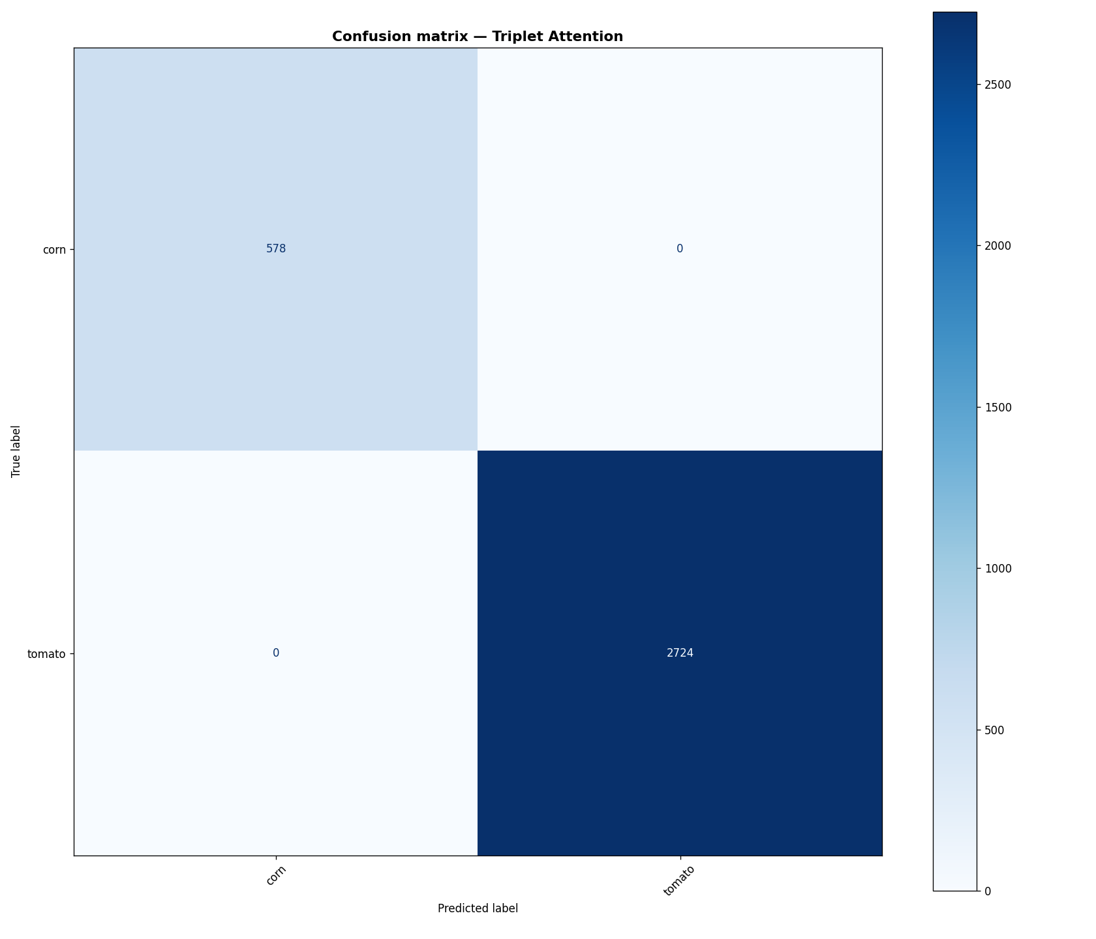
Triplet Attention Module Architecture Diagram

Slide 11
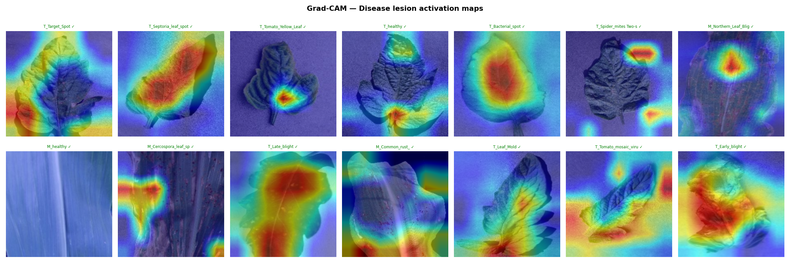
Training Strategy
Phase 1: Feature Extraction: Frozen EfficientNet-B0 backbone, classification head trained with learning rate eta = 1e-3 (10 epochs).
Phase 2: Fine-Tuning: Unfrozen backbone, all layers fine-tuned end-to-end with reduced learning rate eta = 1e-5 (30 epochs).
Categorical Cross-Entropy with Label Smoothing: Replaces hard one-hot targets with smoothed distribution (eps = 0.1) to prevent overconfident false positives. (Szegedy et al., 2016)
Adam Optimizer: Configured with beta1 = 0.9, beta2 = 0.999, eps = 1e-7 for smooth gradient convergence. (Kingma & Ba, 2014)
Adaptive Callbacks: Early stopping (patience=7 on val_loss) and ReduceLROnPlateau (factor=0.2, patience=3) guarantee robust generalization.

Slide 12
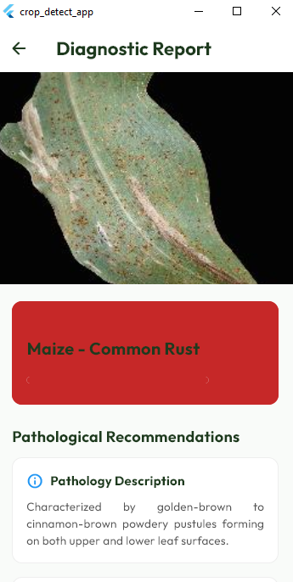
Training and Validation Accuracy & Loss Curves

Slide 13
Results and Metrics
Test Classification Accuracy: 97.85% INT8 test accuracy across 14 classes (FP32 baseline: 98.24% - only 0.39% trade-off!).
Balanced F1-Scores: Weighted Precision: 0.979 | Weighted Recall: 0.978 | Macro F1-Score: 0.978 (12/14 classes >= 0.95).
Ultra-Low Mobile Latency: 92 ms per image on mid-range Android smartphone (vs. 280 ms for MobileNetV2 in literature).
Extreme Edge Footprint: 5.1 MB INT8 TFLite model size (74.9% storage reduction from 20.3 MB FP32 Keras).
Comparative Literature Benchmark: Outperforms AlexNet (~200 MB, 93.5%), DenseNet-121 (~130 MB, 97.2%), and MobileNetV2 (14 MB, 95.8%). (Mohanty et al., 2016; Too et al., 2019; Agarwal et al., 2021)

Slide 14
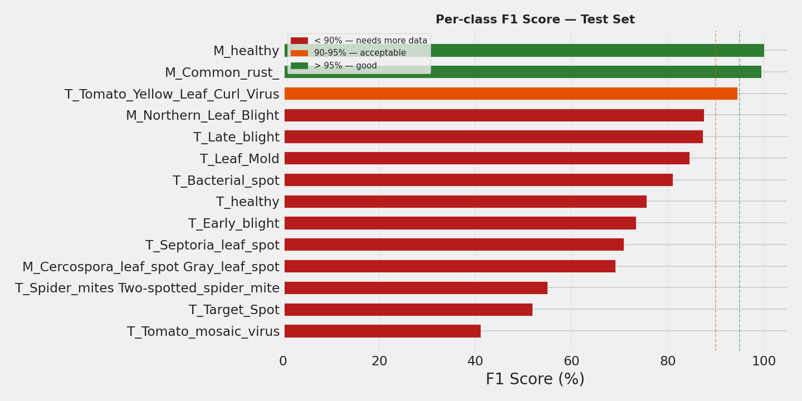
14-Class Confusion Matrix & Per-Class F1-Scores

Slide 15
Mobile App Integration
Cross-Platform Flutter Architecture: Native compilation to Android ARM64 binaries for smooth 60 FPS user experience. (Sarker et al., 2024)
Real-Time Camera Scanner: Interactive camera interface with leaf framing guide, auto-resizing (224x224), and normalization.
Embedded SQLite Database: 100% offline storage of 14 disease profiles, chemical agrochemical dosages, and organic cultural remedies.
Diagnostic Confidence Slider: Default 80% threshold flags low-certainty scans to prevent misdiagnosis under poor field lighting.
Historical Diagnostic Audit Log: Persists past scans, disease severity, timestamps, and GPS coordinates for farm health monitoring.

Slide 16
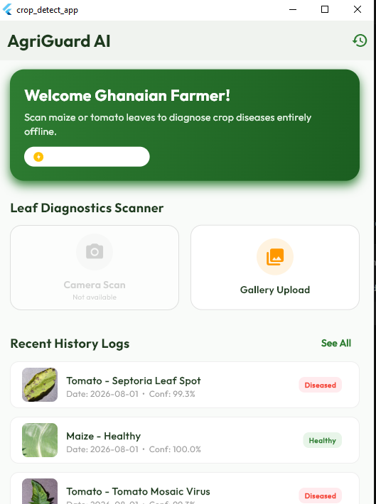
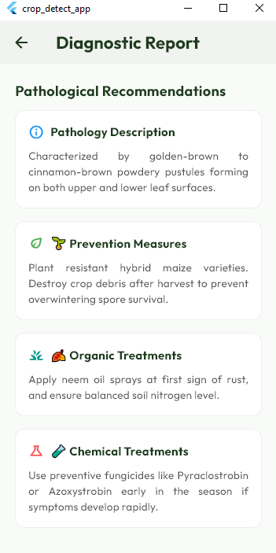
Mobile Application Interface & Treatment UI

Slide 17
Grad-CAM Heatmaps
Mathematical Formulation: Computes gradients of predicted class score y^c with respect to final conv feature maps A^k. (Selvaraju et al., 2017)
Heatmap Color Spectrum Guide: Essential visual verification guide for farmers and agricultural extension officers: (Rahman et al., 2024; Vyas et al., 2023)
Red & Yellow (Warm Tones): Peak neural attention - directly focused on necrotic lesions, chlorotic rings, and rust pustules.
Green (Transitional): Moderate neural activation marking transitional leaf tissue boundaries.
Blue & Purple (Cool Tones): Zero neural attention - healthy green leaf tissue, stems, and background soil are ignored.
40/60 Alpha Blending: Heatmap overlaid at 40% opacity over original 60% leaf image for intuitive visual correlation.

Slide 18
Grad-CAM Feature Attention Heatmaps Across Disease Classes

Slide 19
Conclusion and Recommendation
Summary of Achievements: Successfully developed a 97.85% accurate, 5.1 MB lightweight, 92 ms fast, 100% offline crop diagnostic mobile system.
Primary Conclusion: INT8-quantized EfficientNet-B0 fused with Triplet Attention proves that high-accuracy, transparent AI is viable on budget mobile devices.
Empirical Usability Validation: Attained a System Usability Scale (SUS) score of 76.5 / 100 (Grade B+ 'Good'), confirming strong field acceptability. (Brooke, 1996; Bangor et al., 2008)
Recommendation 1 (Crop Expansion): Extend dataset to Ghanaian staple cash crops: Cassava (mosaic virus), Cocoa (black pod), and Plantain.
Recommendation 2 (Edge YOLO Video): Integrate real-time video stream multi-leaf bounding box detection for drone/tractor mounting.
Recommendation 3 (Indigenous Voice Audio): Incorporate automated voice audio narration of treatment remedies in Ghanaian languages (Twi, Fante, Ewe, Dagbani).

Slide 20
References (Part 1)
Agarwal, M., Singh, A., Arjaria, S., Sinha, A., & Gupta, S. (2021). ToLeD: Tomato leaf disease detection using mobile-friendly deep learning. Computers and Electronics in Agriculture, 186, 106208.
Bangor, A., Kortum, P. T., & Miller, J. T. (2008). An empirical evaluation of the system usability scale. International Journal of Human-Computer Interaction, 24(6), 574–594.
Brooke, J. (1996). SUS-A quick and dirty usability scale. Usability Evaluation in Industry, 189(194), 4–7.
Danquah, E. O., Asante, M., & Mensah, K. A. (2024). Smallholder farming and agricultural extension constraints in West Africa. African Journal of Agricultural Research, 19(3), 204–218.
Hu, J., Shen, L., & Sun, G. (2018). Squeeze-and-excitation networks. IEEE/CVF CVPR, 7132–7141.
Hughes, D., & Salathe, M. (2015). An open access repository of images on plant health to enable the development of mobile disease diagnostics. arXiv:1511.08060.

Slide 21
References (Part 2)
Misra, D., Shrivastava, S., & Ramasamy, M. (2021). Rotate to attend: Convolutional triplet attention module. IEEE/CVF WACV, 3139–3148.
Mohanty, S. P., Hughes, D. P., & Salathe, M. (2016). Using deep learning for image-based plant disease detection. Frontiers in Plant Science, 7, 1419.
Rahman, T., Al-Mahi, M., & Hossain, M. A. (2024). Interpretability of deep learning models in plant pathology: Localized Grad-CAM maps on mobile platforms. Computers in Biology and Medicine, 170, 107955.
Selvaraju, R. R., Cogswell, M., Das, A., Vedantam, R., Parikh, D., & Batra, D. (2017). Grad-CAM: Visual explanations from deep networks via gradient-based localization. IEEE ICCV, 618–626.
Tan, M., & Le, Q. (2019). EfficientNet: Rethinking model scaling for convolutional neural networks. ICML, 6105–6114.
Too, E. C., Yujian, L., Njuki, S., & Yingchun, L. (2019). A comparative study of fine-tuning deep learning models for plant disease identification. Computers and Electronics in Agriculture, 161, 272–279.

